Slide 1
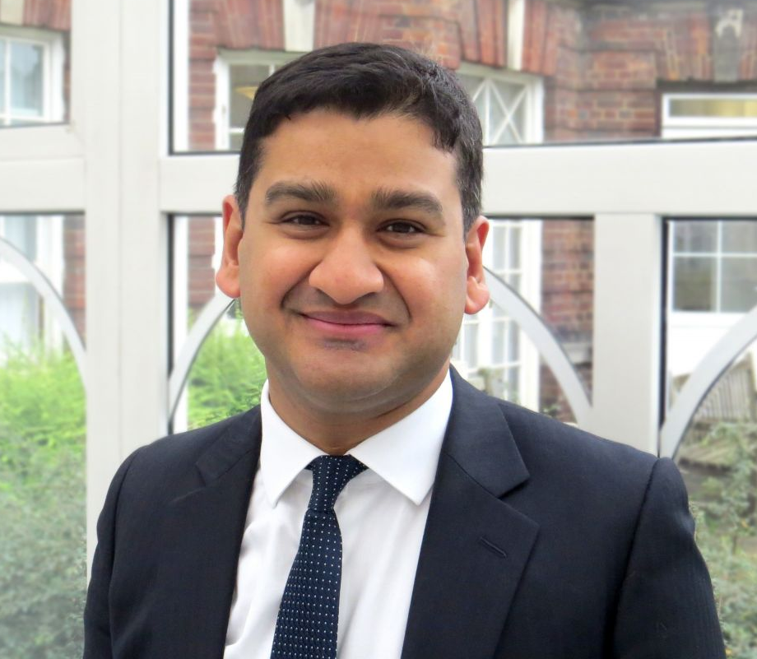
Dr Shouvik Haldar
Consultant Cardiologist & Electrophysiologist
Royal Brompton & Harefield NHS Foundation Trust
Presentation Title​ Here
Dr Shouvik Haldar is a Consultant Cardiologist & Electrophysiologist at the Royal Brompton & Harefield NHS Foundation Trust. He graduated from Guy’s and St Thomas’s Medical School, trained in NW Thames Cardiology Training Programme and completed his subspecialty training at the Royal Brompton & Harefield NHS Foundation Trust and the University of Toronto. He has a strong research record, publishing many peer reviewed articles, and is an invited speaker at international conferences and meetings in the US and Europe. Dr Haldar is passionate about medical education and is currently Chair of Education at the British Cardiovascular Society.
EXAMPLE TEMPLATE
PLEASE EDIT FOR YOUR TALK

Slide 2
Conflict of Interest
Please ensure you complete the conflict of interest slide,
if there are none please state this on the slide.

Slide 10
Explore the
Exhibition Hall
and don’t forget to collect your free patient resources from the Arrhythmia Alliance booth
↗ www.heartrhythmcongress.org
) UK +44 1789 867501
) US +1 843 415 1886
 info@heartrhythmcongress.org.uk

